Slide 1

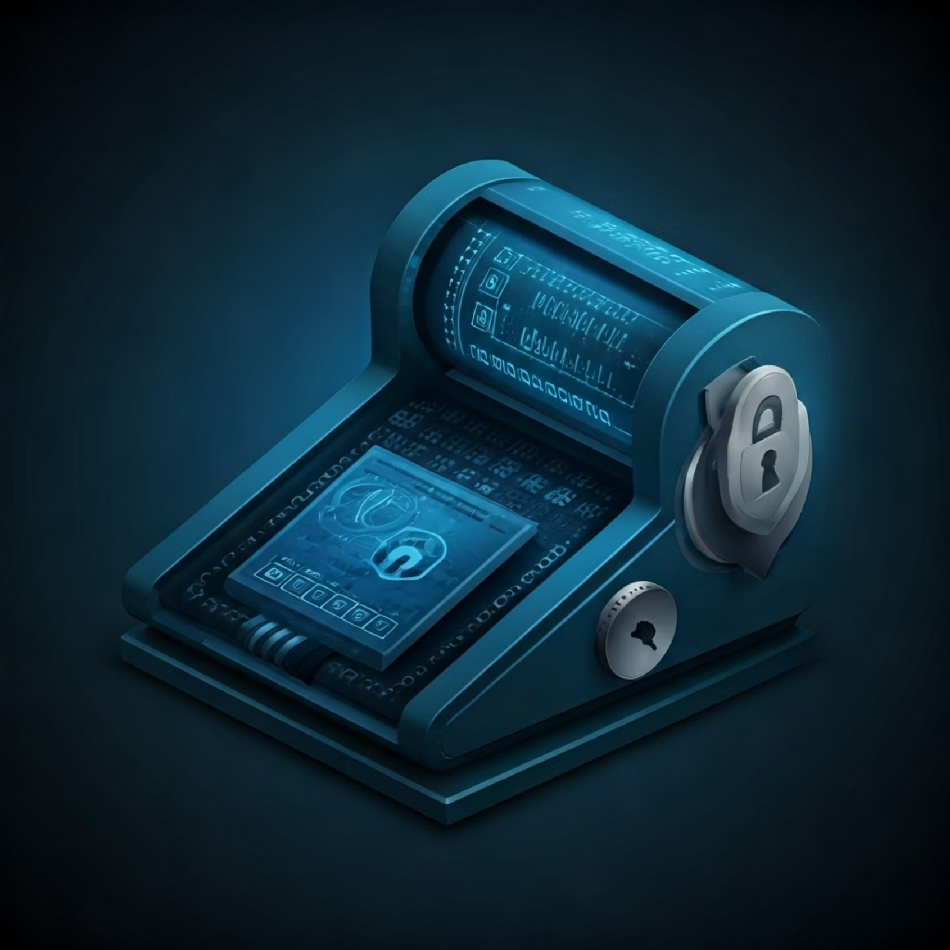
IEC COLLEGE OF ENGINEERING AND TECHNOLOGY
GREATER NOIDA
MINI PROJECT ON
“PASSWORD GENERATOR”
SUBMITTED BY :
ANU KUMAR (2200900100027)

Slide 2
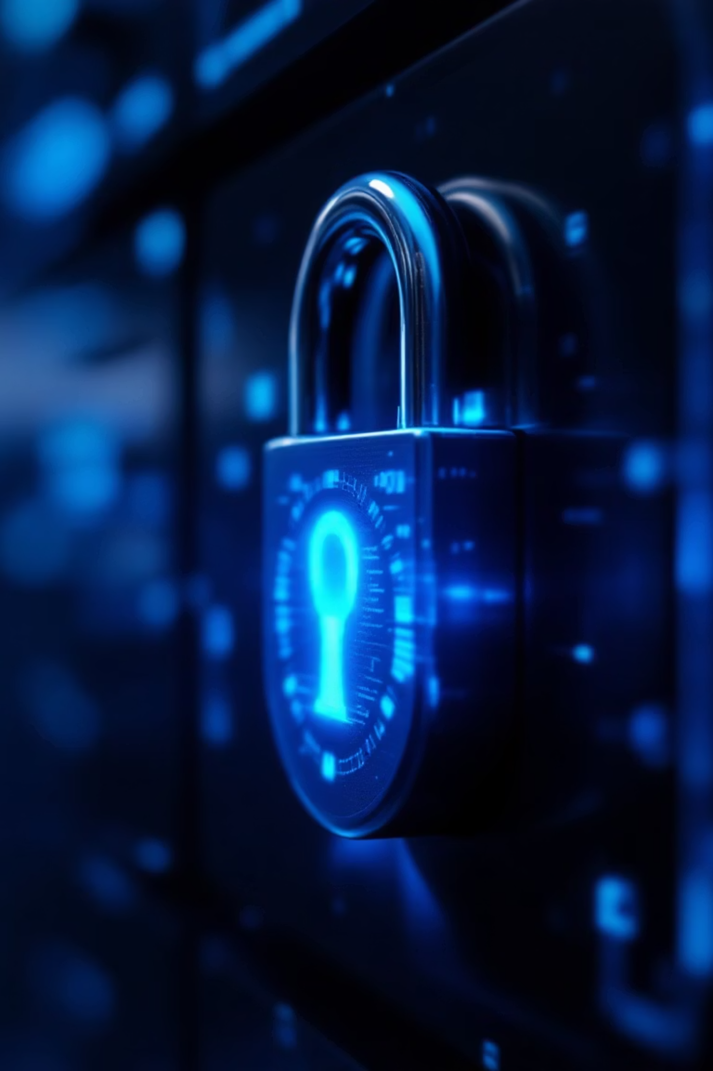
Crafting Secure Passwords: A Python Approach
Ensuring digital safety with robust, automatically generated passwords.

Slide 3




The Password Predicament: Why Strong Passwords Matter
Cyber Threats
Data Privacy
Digital Identity
Weak passwords are the leading cause of data breaches and cyber-attacks globally. Protecting sensitive information starts here.
Safeguard personal and organisational data from unauthorised access. A strong password is your first line of defence.
Your online identity is a valuable asset. Prevent identity theft and fraud by ensuring every account has a unique, complex password.

Slide 4
Demystifying Password Generators: What They Are
A password generator is a software tool designed to create random and unique passwords that are highly resistant to brute-force attacks and dictionary attacks.
It typically combines various character types—uppercase letters, lowercase letters, numbers, and special characters—to produce a string of characters with specified length and complexity.

Slide 5
Python's Prowess: Why It's Ideal for This Task
Simplicity & Readability
Extensive Libraries
Platform Agnostic
The language offers powerful built-in modules like random and string, providing all the necessary tools for character selection and randomisation.
Python scripts can run seamlessly across various operating systems, making your password generator universally accessible.
Python's clean syntax makes it easy to write and understand the code for password generation, facilitating quick development and debugging.

Slide 6

Core Components: Defining Password Strength & Character Sets
Character Sets
Password Strength Factors
Lowercase letters (a-z)
Length: Longer passwords are harder to crack.
Uppercase letters (A-Z)
Diversity: Mix of character types for unpredictability.
Digits (0-9)
Special characters (!@#$%^&*)
Randomness: Truly random sequences are key.

Slide 7
Code Walkthrough 1: Leveraging Python's random Module
The random module is crucial for generating unpredictable characters. Here's how to use its key functions:
import randomimport string# Define character setslower = string.ascii_lowercaseupper = string.ascii_uppercasedigits = string.digitssymbols = string.punctuation# Example: picking a random character from a stringrandom_lower = random.choice(lower)random_upper = random.choice(upper)print(f"Random lowercase: {random_lower}")print(f"Random uppercase: {random_upper}")
We combine these sets to create a pool of all possible characters for our strong passwords.

Slide 8
Code Walkthrough 2: Building the Generator Function
Let's assemble these parts into a function that generates a password of a specified length.
def generate_password(length): all_characters = string.ascii_letters + string.digits + string.punctuation password = ''.join(random.choice(all_characters) for i in range(length)) return password# Generate a 12-character passwordmy_password = generate_password(12)print(f"Generated Password: {my_password}")
This basic function randomly selects characters from the combined set, ensuring a diverse and secure password.

Slide 9
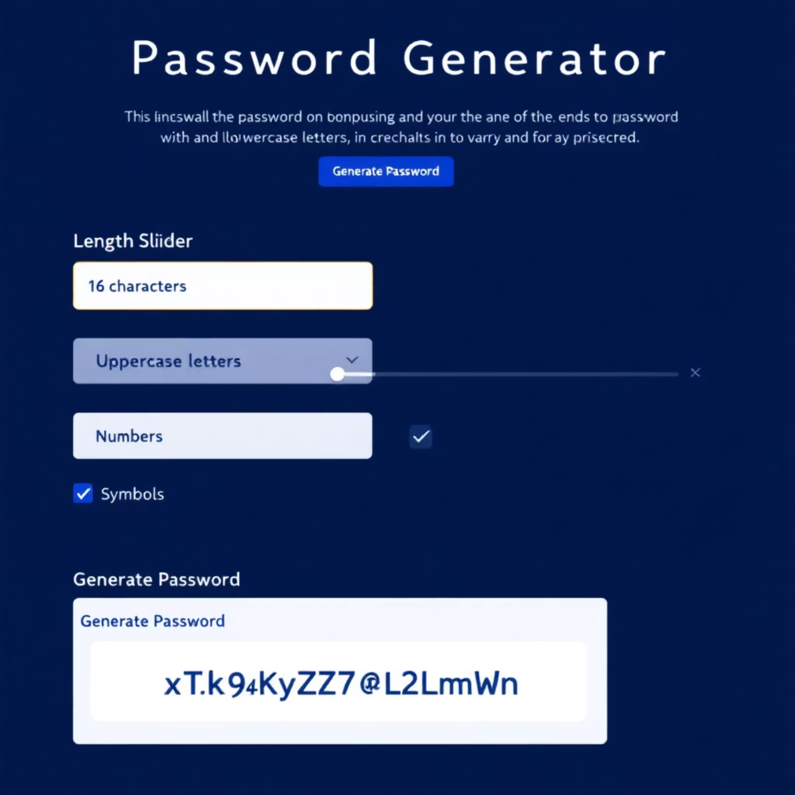
Enhancing Functionality: User Input & Customisation Options
To make the generator more user-friendly, we can add options for customisation:
Password Length: Allow users to specify how long their password should be.
Character Inclusion: Enable selection of character types (e.g., exclude symbols, always include numbers).
Quantity: Generate multiple passwords at once.
This flexibility caters to varying security requirements and personal preferences.

Slide 10

Ethical Considerations: Secure Usage & Best Practices
Never Share Passwords
Use a Password Manager
Enable Two-Factor Authentication (2FA)
Keep your generated passwords strictly confidential. Sharing them compromises their security immediately.
Instead of memorising complex passwords, store them securely in a reputable password manager.
Add an extra layer of security beyond just passwords for critical accounts.

Slide 11
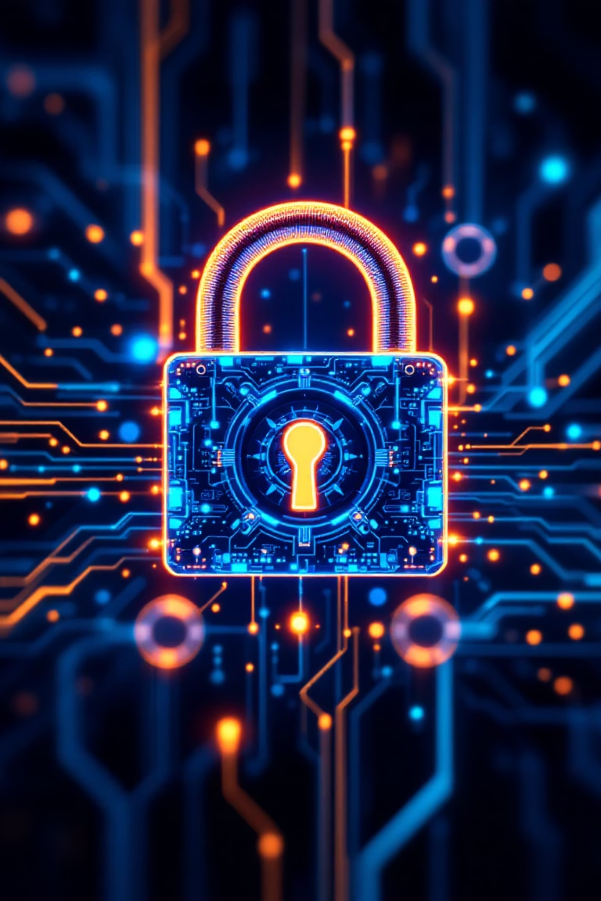
Q&A & Future Scope: Keep Your Digital Locks Strong
Q&A: Your questions on secure password generation and Python implementation.
Future Enhancements: Consider adding features like checking password entropy, integrating with secure key storage, or building a GUI.
Stay Updated: Cybersecurity threats evolve. Regularly review and update your password practices and tools.

